Slide 1
Group 4:
Raghav Chopra (C0772292)
Topic: Interfacing of Beaglebone black with Buzzer

Slide 2
Contents
Task objective
Components required for interfacing
Introduction of Beaglebone black
Pin description of beaglebone black
Specifications of Beaglebone black
Introduction of Buzzer
Types of buzzer
Pin configuration of buzzer

Slide 3
Cont.
Specifications of buzzer
Applications of buzzer
Hardware Connections
Connections of Buzzer with BBB
Connections of IR Sensor with BBB
Connections of Push Button with BBB
Code
Output
References

Slide 4
Task objective
Main objective of this task is to interface the buzzer with Beaglebone black.
To establish proper hardware connections so that both the components will communicate smoothly.
To run the code properly and get the accurate output on the terminal.

Slide 5
Components required for interfacing
Hardware requirements:
Beaglebone black
Buzzer
IR Sensor
Push Button
Jumper wires
USB cable

Slide 6
Software requirements
Debian image for Beaglebone black
Linux operating system
Gcc compiler
GNU nano editor

Slide 7
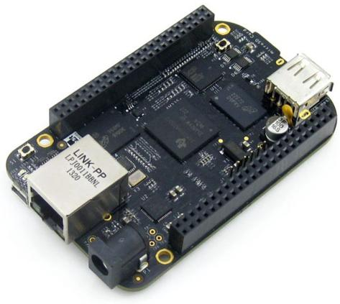
Introduction of Beaglebone black
The Beaglebone black is a low cost, open hardware and expandable computer launched by a community of developers from Texas Instruments. It consists of large amount of input and output pins and also it has on board interfaces which enables the devices to connect smoothly with the beaglebone black.

Slide 8
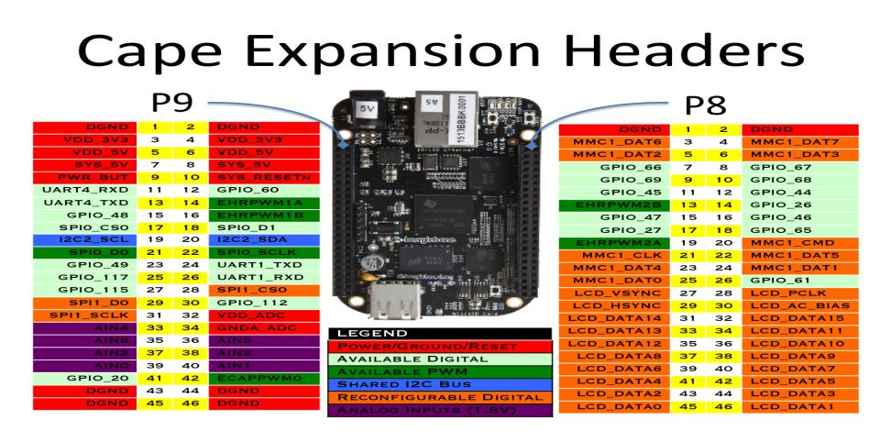
Pin description of Beaglebone black

Slide 9
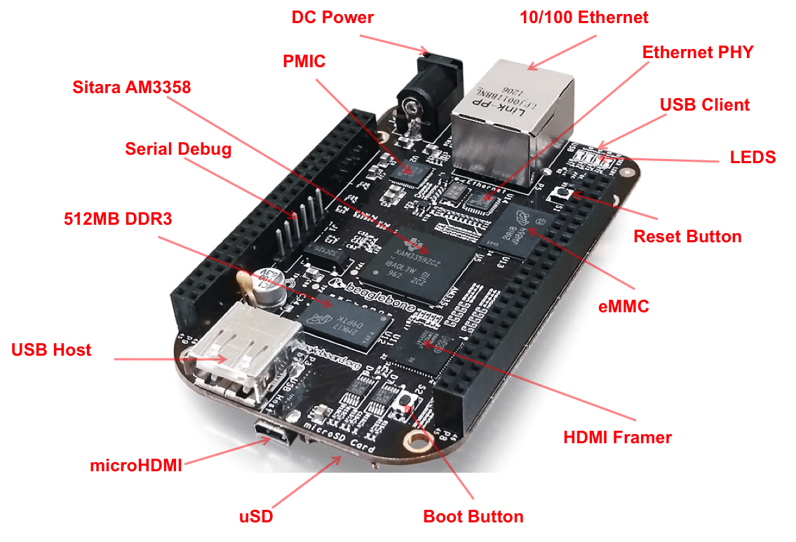
Specifications of Beaglebone black

Slide 10
Technical specifications
Processor -- Sitara AM3358BZCZ100 1 GHz 2000MIPS
SDRAM memory -- 512MB DDR3L 800 MHz
On board flash -- 4GB, 8-bit Embedded MMC
Debug support -- Optional Onboard 20-pin CTI JTAG, serial header
Power source -- miniUSB, USB and 5V DC External
PCB -- 3.4” x 2.1” 6 layers
Indicators -- 1 Power, 2 Ethernet, 4-User controllable LED’s
HS USB-2.0 Client port -- Access to USB0, Client mode via miniUSB

Slide 11
Cont.
HS USB 2.0 Host port -- Access to USB1, Type A socket
Serial port -- UART0 Access via 6-pin 3.3V TTL header
Ethernet -- 10/100, RJ45
SD/MMC Connector -- microSD, 3.3V
User input -- Reset Button, Power Button, Boot Button
Video out -- 16b HDMI, 1280 x 1024 (MAX)
Audio -- Via HDMI interface, Stereo
Expansion Connectors -- Power 5V, 3.3V, VDD_ADC (1.8V), 3.3V I/O on all signals, McASP0, SPI1, I2C, GPIO(69MAX), LCD, MMC1, MMC2, 4 timers, 4 serial ports, CAN0, XDMA Interrupt, Power button, Expansion board ID.

Slide 12
Features of Beaglebone black
Large number of GPIO I/O pins
High performance computing experience
Supports deterministic execution hardware via dedicated processing unit
Robust and wide options for connectivity
Open source hardware technology- it gives options to manufactures to integrate ARM technology for developing cloned beaglebone development boards.
Open source software technology- it provides options to install wide range of android and linux based operations systems.

Slide 13
Applications of Beaglebone black
Robotics
Micro controller
Automation
IOT
AWS
Bluetooth connectivity projects

Slide 14
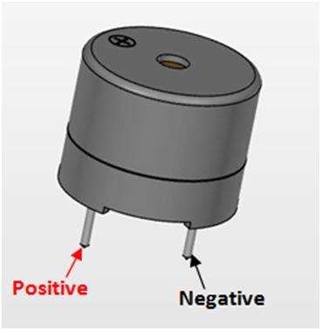
Introduction of Buzzer
It is a signalling device which may be mechanical, electromechanical or piezoelectric and we can use buzzers in electronic circuits to avoid the failure or any kind of mishappening.

Slide 15
Types of Buzzer
Piezoelectric buzzers
Magnetic buzzers
Mechanical buzzers
Electromechanical buzzers
Electromagnetic buzzers

Slide 16
Pin configuration of buzzer
Positive Pin: Identified by (+) symbol or longer terminal lead. It can be powered by 6V DC
Negative Pin: Identified by short terminal lead and typically connected with the ground of the circuit.

Slide 17
Specifications of the Buzzer
Rated voltage: 6V DC
Operating voltage: 4-8V DC
Rated current: <30mA
Sound type: Continuous beep
Small and neat sealed package
Resonant frequency: ~2300 Hz

Slide 18
Applications of Buzzer
Alarming circuits, where the user has to be alarmed about something.
Communication equipments
Automobile electronics
Portable equipments due to its compact size

Slide 19
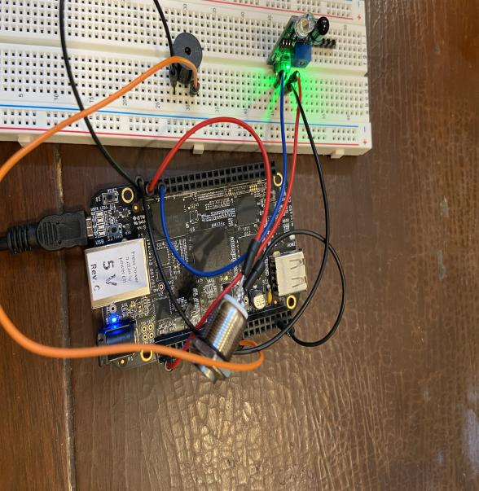
Hardware Connections:

Slide 20
Connections of Buzzer with Beaglebone Black
The positive (+ve) pin of Buzzer is connected with pin 23 of header 9 of beaglebone black.
The negative (-ve) pin of Buzzer has been grounded.

Slide 21
Connections of IR Sensor with Beaglebone Black
The output pin of IR Sensor is connected to pin 7 of header 8 of beaglebone black.
Ground pin of both the components has been connected to each other.
5V power supply has been provided to Vcc pin of IR Sensor.

Slide 22
Connections of Push Button with Beaglebone Black
One pin of push button is connected to pin 41 of header 9 of beaglebone black.
3.3V power supply has been provided to the other pin of push button.

Slide 23
Code:
#include <stdio.h> //includes standard I/O header files
#include <iobb.h> //includes GPIO I/O header files
#include <unistd.h> //includes POSIX API library for adding delay in operation
#define Buzzer 9,23 //pin 23 of header 9
#define PushButton 9,41 //pin 41 of header 9
#define IRbtwnDoor 8,7 //pin 7 of header 8

Slide 24
Code:
int main(void) // main function
{
iolib_init(); // initializing GPIO I/O library
iolib_setdir(IRbtwnDoor, DigitalIn); //setting GPIO pin of IR sensor for input
iolib_setdir(Buzzer, DigitalOut); //setting GPIO pin of Buzzer
iolib_setdir(PushButton, DigitalIn); //setting GPIO pin of push button for input
while(1) //continuous loop
{
if (is_high (IRbtwnDoor)) //if pin 7 of header 8 is low
{
printf(“Door Closed \n”); //print on terminal
pin_low(Buzzer); // Buzzer remains disabled
usleep (1200000); //delay operation
}

Slide 25
Code:
if (is_low (IRbtwnDoor)) //if pin 7 of header 8 is high
{
printf(“Obstacle \n”); //print on terminal
pin_high(Buzzer); // Buzzer will be enabled
usleep (1200000); //delay operation
if (is_high (PushButton)) //when button is pressed
{
printf(“Buzzer is disabled \n”); //print on terminal
pin_low(Buzzer); //Buzzer will be disabled
usleep (1200000); //delay operation
}
}
}
iolib_free(); //end of program (free library resources)
return(0); //return a value
}

Slide 26
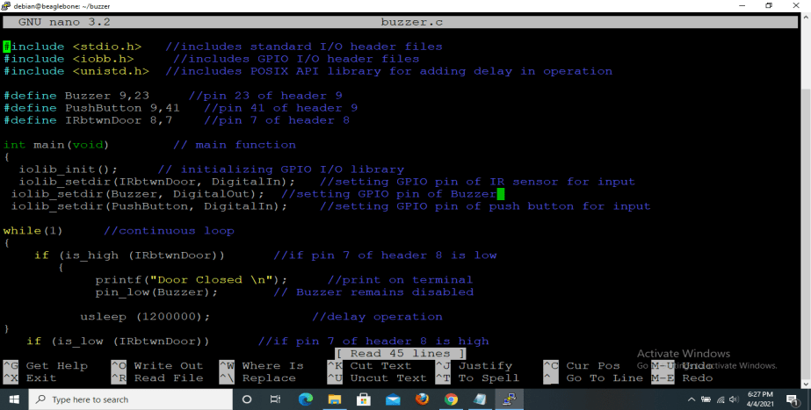
Code:

Slide 27
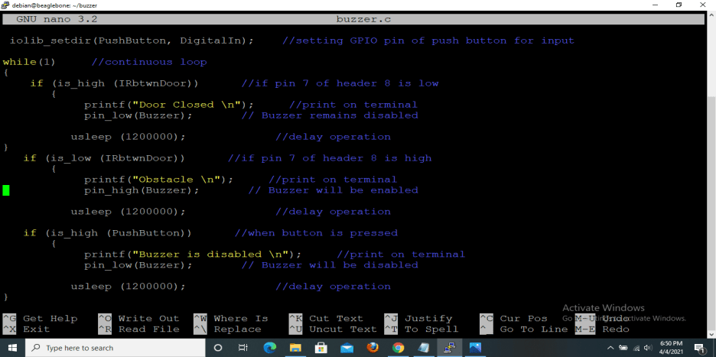
Code:

Slide 28
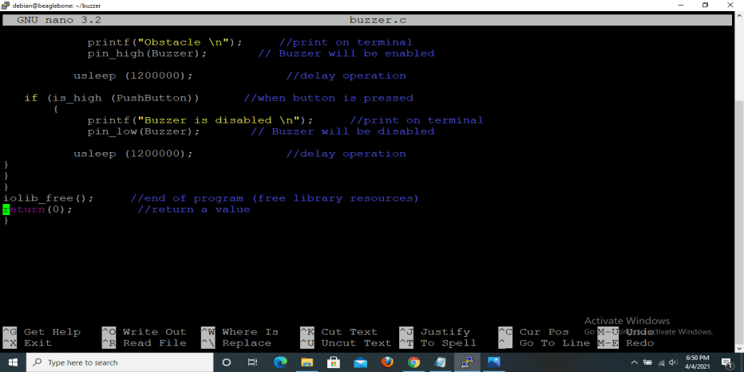
Code:

Slide 29
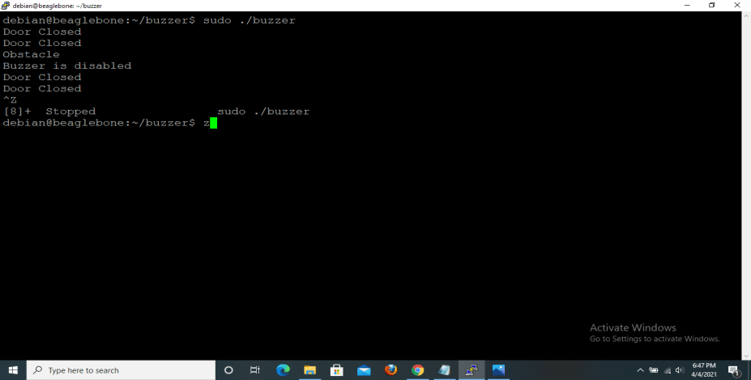
Output:

Slide 30
References
Retrieved from packtpub.com, URL: https://www.google.com/search?q=specifications+of+beaglebone+black&rlz=1C1CHBF_enCA938CA938&sxsrf=ALeKk02SOVwIYucUpkFlJqUkW9cdSc-Cig:1615258170349&tbm=isch&source=iu&ictx=1&fir=UQi1UObyKlwp9M%252CNVwgpvjj0xU_DM%252C_&vet=1&usg=AI4_-kR3FYuOieNFDMdjZlcqZfZEl1HZzQ&sa=X&ved=2ahUKEwjEztrLmaLvAhXEF1kFHVfJDzoQ_h16BAgMEAE#imgrc=UQi1UObyKlwp9M
Retrieved from components101.com, URL: https://components101.com/misc/buzzer-pinout-working-datasheet
Retrieved from elements14.com, URL: https://www.element14.com/community/community/designcenter/single-board-computers/next-genbeaglebone/blog/2013/10/10/bbb--beaglebone-black-io-library-for-c
Retrieved from man7.org, URL: https://man7.org/linux/man-pages/man3/usleep.3.html

